Slide 1



Slide 3


Slide 5


Windows 13

Slide 6






Windows 13
Language to Install
English (United States)
Time & currency format
English (United States)
Keyboard or input method
US
Enter Your preferences and click “Next” to continue
Next
Microsoft corporations all rights reserved
TM

Slide 7
Windows 13
Install now
Repair Your PC
Microsoft corporations all rights reserved
TM

Slide 9
1
2
3
Collecting Information
Installing Windows 13
Finishing Up

Slide 10






Windows Setup
Activate Windows
If this is the first time, you’re installing Windows on this PC (or you’re installing a different edition)
You need to enter a valid Windows product key. Your Product key should be in the confirmation
Email you received after buying a digital copy of windows or on a label inside the box that windows
Came in.
The product key should look like this: XXXXX-XXXXX-XXXXX-XXXXX-XXXXX
if you don’t have a valid product key, select I don’t have a product key. Then you must have a 30 days
Trial and after trial ends, you must insert a valid product key.
I Don’t have a product key
Next
1
2
3
Collecting Information
Installing Windows 13
Finishing Up

Slide 11

Windows Setup
Activate Windows
If this is the first time, you’re installing Windows on this PC (or you’re installing a different edition)
You need to enter a valid Windows product key. Your Product key should be in the confirmation
Email you received after buying a digital copy of windows or on a label inside the box that windows
Came in.
The product key should look like this: XXXXX-XXXXX-XXXXX-XXXXX-XXXXX
if you don’t have a valid product key, select I don’t have a product key. Then you must have a 30 days
Trial and after trial ends, you must insert a valid product key.
WC2BQ-8NRM3-FDDYY-2BFGV-KHKQY
I Don’t have a product key
Next
1
2
3
Collecting Information
Installing Windows 13
Finishing Up

Slide 12

Windows Setup
Choose your edition
6 editions available
OS Edition
Architecture
Windows 13 Pro
x64
Windows 13 Home
x64
Windows 13 Education
x64
Windows 13 Pro Education
x64
Windows 13 Enterprise
x64
Windows 13 SE
x64
Next
1
2
3
Collecting Information
Installing Windows 13
Finishing Up

Slide 13
Windows Setup
Choose your edition
6 editions available
OS Edition
Architecture
Windows 13 Pro
x64
Windows 13 Home
x64
Windows 13 Education
x64
Windows 13 Pro Education
x64
Windows 13 Enterprise
x64
Windows 13 SE
x64
Next
1
2
3
Collecting Information
Installing Windows 13
Finishing Up

Slide 14


Windows Setup
License terms
Please read the license terms
MICROSOFT SOFTWARE LICENSE TERMS
WINDOWS OPERATING SYSTEM
IF YOU LIVE IN (OR IF YOUR PRINCIPAL PLACE OF BUSINESS IS IN) THE UNITED STATES, PLEASE READ THE BINDING ARBITRATION CLAUSE AND CLASS ACTION WAIVER IN SECTION 11. IT AFFECTS HOW DISPUTES ARE RESOLVED.
Thank you for choosing Microsoft!
Next
I accept the license terms
1
2
3
Collecting Information
Installing Windows 13
Finishing Up

Slide 15

Windows Setup
License terms
Please read the license terms
MICROSOFT SOFTWARE LICENSE TERMS
WINDOWS OPERATING SYSTEM
IF YOU LIVE IN (OR IF YOUR PRINCIPAL PLACE OF BUSINESS IS IN) THE UNITED STATES, PLEASE READ THE BINDING ARBITRATION CLAUSE AND CLASS ACTION WAIVER IN SECTION 11. IT AFFECTS HOW DISPUTES ARE RESOLVED.
Thank you for choosing Microsoft!
Next
I accept the license terms
1
2
3
Collecting Information
Installing Windows 13
Finishing Up

Slide 16



Windows Setup
Which installation type you want? Select any option.
Note: Upgrade is disabled, to start upgrade, start a Windows installation (old and used) and start this windows installation
UPGRADE Install Windows but all files, settings, photos, etc. Are kepten.
CUSTOM Installs Windows but all your files will be deleted, we recomended you backing up
your files.
1
2
3
Collecting Information
Installing Windows 13
Finishing Up

Slide 17
Windows Setup
Which installation type you want? Select any option.
Note: Upgrade is disabled, to start upgrade, start a Windows installation (old and used) and start this windows installation
UPGRADE Install Windows but all files, settings, photos, etc. Are kepten.
CUSTOM Installs Windows but all your files will be deleted, we recomended you backing up
your files.
Next
1
2
3
Collecting Information
Installing Windows 13
Finishing Up

Slide 18








Windows Setup
Select a Disk Drive to install Windows.
Total size Free space Type
Disk 0 Unallocated Space 3 TB 3 TB SSD
Browse CD \ DVD \ USB
Refresh
Add
Delete
Format
Next
1
2
3
Collecting Information
Installing Windows 13
Finishing Up

Slide 19
Windows Setup
Select a Disk Drive to install Windows.
Total size Free space Type
Disk 0 Unallocated Space 3 TB 3 TB SSD
Browse CD \ DVD \ USB
Refresh
Add
Delete
Format
Next
1
2
3
Collecting Information
Installing Windows 13
Finishing Up

Slide 20
Windows Setup
Select a Disk Drive to install Windows.
Total size Free space Type
Disk 0 Unallocated Space 3 TB 3 TB SSD
Browse CD \ DVD \ USB
Refresh
Add
Delete
Format
Next
1
2
3
Collecting Information
Installing Windows 13
Finishing Up

Slide 21
1
2
3
Collecting Information
Installing Windows 13
Finishing Up
Welcome to Windows 18 2024!
Now you’re installing the best version of Windows! We look forward to showing it to you!

Slide 22
Welcome to Windows 13 2024!
Now you’re installing the best version of Windows! We look forward to showing it to you!
1
2
3
Collecting Information
Installing Windows 13
Finishing Up

Slide 23
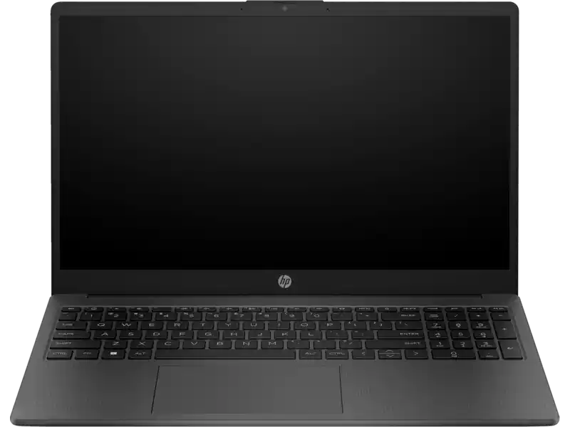
Welcome to Windows 18 2024!
Now you’re installing the best version of Windows! We look forward to showing it to you!
1
2
3
Collecting Information
Installing Windows 13
Finishing Up

Slide 24
Welcome to Windows 18 2024!
Now you’re installing the best version of Windows! We look forward to showing it to you!
Laptops! Smooth and light
Windows 13 is very good idea for laptops! And you can use the fingerprint! All good is in laptops!
1
2
3
Collecting Information
Installing Windows 13
Finishing Up

Slide 25

Welcome to Windows 18 2024!
Now you’re installing the best version of Windows! We look forward to showing it to you!
1
2
3
Collecting Information
Installing Windows 13
Finishing Up
Laptops! Smooth and light
Windows 13 is very good idea for laptops! And you can use the fingerprint! All good is in laptops!

Slide 26
Welcome to Windows 18 2024!
Now you’re installing the best version of Windows! We look forward to showing it to you!
1
2
3
Collecting Information
Installing Windows 13
Finishing Up
Laptops! Smooth and light
Windows 13 is very good idea for laptops! And you can use the fingerprint! All good is in laptops!

Slide 27
Welcome to Windows 18 2024!
Now you’re installing the best version of Windows! We look forward to showing it to you!
1
2
3
Collecting Information
Installing Windows 13
Finishing Up
Laptops! Smooth and light
Windows 13 is very good idea for laptops! And you can use the fingerprint! All good is in laptops!

Slide 28
Welcome to Windows 18 2024!
Now you’re installing the best version of Windows! We look forward to showing it to you!
Compatibile for tablets
Windows 18 is smoothly running on tablets or laptops with tablet mode!
1
2
3
Collecting Information
Installing Windows 13
Finishing Up
Laptops! Smooth and light
Windows 13 is very good idea for laptops! And you can use the fingerprint! All good is in laptops!
Compatibile for tablets
Windows 13 is smoothly running on tablets or laptops with tablet mode!

Slide 29
Welcome to Windows 18 2024!
Now you’re installing the best version of Windows! We look forward to showing it to you!
Compatibile for tablets
Windows 13 is smoothly running on tablets or laptops with tablet mode!
1
2
3
Collecting Information
Installing Windows 13
Finishing Up
Laptops! Smooth and light
Windows 13 is very good idea for laptops! And you can use the fingerprint! All good is in laptops!

Slide 30

Compatibile for tablets
Windows 13 is smoothly running on tablets or laptops with tablet mode!
Welcome to Windows 18 2024!
Now you’re installing the best version of Windows! We look forward to showing it to you!
Windows Copilot
New Windows 13 Copilot
Say Hello to Windows 13 Copilot. Microsoft’s AI Features Virtual assistant. It Understands and anticipates your needs, making suggestions for tasks, setting reminders, and providing helpful insights.
It seamlessly works across all your devices., making it a true personal assistant.
Good Afternoon!
Write your massage
Turn on dark mode
Sure!
1
2
3
Collecting Information
Installing Windows 13
Finishing Up
Laptops! Smooth and light
Windows 13 is very good idea for laptops! And you can use the fingerprint! All good is in laptops!
Compatibile for tablets
Windows 18 is smoothly running on tablets or laptops with tablet mode!

Slide 31
Welcome to Windows 18 2024!
Now you’re installing the best version of Windows! We look forward to showing it to you!
Windows Copilot
New Windows 13 Copilot
Say Hello to Windows 13 Copilot. Microsoft’s AI Features Virtual assistant. It Understands and anticipates your needs, making suggestions for tasks, setting reminders, and providing helpful insights.
It seamlessly works across all your devices., making it a true personal assistant.
Good Afternoon!
Write your massage
Turn on dark mode
Sure!
1
2
3
Collecting Information
Installing Windows 13
Finishing Up
Laptops! Smooth and light
Windows 13 is very good idea for laptops! And you can use the fingerprint! All good is in laptops!
Compatibile for tablets
Windows 18 is smoothly running on tablets or laptops with tablet mode!

Slide 32
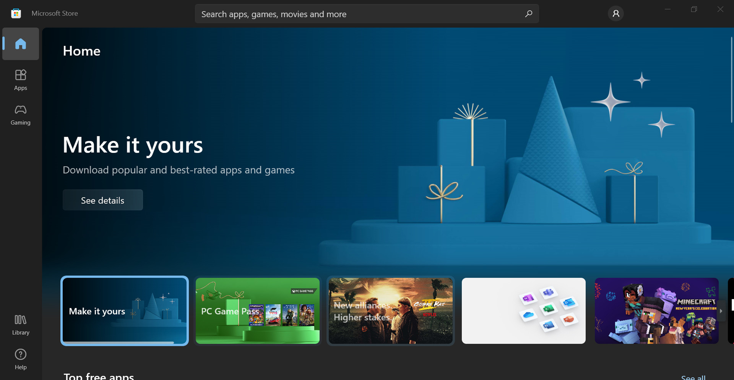

New Windows 13 Copilot
Say Hello to Windows 13 Copilot. Microsoft’s AI Features Virtual assistant. It Understands and anticipates your needs, making suggestions for tasks, setting reminders, and providing helpful insights.
It seamlessly works across all your devices., making it a true personal assistant.
Welcome to Windows 18 2024!
Now you’re installing the best version of Windows! We look forward to showing it to you!
Windows Copilot
Good Afternoon!
Write your massage
Turn on dark mode
Sure!
1
2
3
Collecting Information
Installing Windows 13
Finishing Up
Laptops! Smooth and light
Windows 13 is very good idea for laptops! And you can use the fingerprint! All good is in laptops!
Compatibile for tablets
Windows 18 is smoothly running on tablets or laptops with tablet mode!
Apps you know and love
Quickly find the apps. Games and movies in the new Windows 13 Microsoft Store.
Now Microsoft Store has a tons of the important apps that makes you easier to find it on Windows 13 2024.

Slide 33
New Windows 13 Copilot
Say Hello to Windows 13 Copilot. Microsoft’s AI Features Virtual assistant. It Understands and anticipates your needs, making suggestions for tasks, setting reminders, and providing helpful insights.
It seamlessly works across all your devices., making it a true personal assistant.
Welcome to Windows 18 2024!
Now you’re installing the best version of Windows! We look forward to showing it to you!
Windows Copilot
Apps you know and love
Quickly find the apps. Games and movies in the new Windows 13 Microsoft Store.
Now Microsoft Store has a tons of the important apps that makes you easier to find it on Windows 13 2024.
Good Afternoon!
Write your massage
Turn on dark mode
Sure!
1
2
3
Collecting Information
Installing Windows 13
Finishing Up
Laptops! Smooth and light
Windows 13 is very good idea for laptops! And you can use the fingerprint! All good is in laptops!
Compatibile for tablets
Windows 18 is smoothly running on tablets or laptops with tablet mode!

Slide 34
New Windows 13 Copilot
Say Hello to Windows 13 Copilot. Microsoft’s AI Features Virtual assistant. It Understands and anticipates your needs, making suggestions for tasks, setting reminders, and providing helpful insights.
It seamlessly works across all your devices., making it a true personal assistant.
Welcome to Windows 18 2024!
Now you’re installing the best version of Windows! We look forward to showing it to you!
Windows Copilot
Good Afternoon!
Write your massage
Turn on dark mode
Sure!
1
2
3
Collecting Information
Installing Windows 13
Finishing Up
Laptops! Smooth and light
Windows 13 is very good idea for laptops! And you can use the fingerprint! All good is in laptops!
Compatibile for tablets
Windows 18 is smoothly running on tablets or laptops with tablet mode!
Apps you know and love
Quickly find the apps. Games and movies in the new Windows 13 Microsoft Store.
Now Microsoft Store has a tons of the important apps that makes you easier to find it on Windows 13 2024.
Thank you for download Windows 13 2024!
Some loadings and questions and you can explore Windows 13! Microsoft Windows Team!

Slide 35
New Windows 13 Copilot
Say Hello to Windows 13 Copilot. Microsoft’s AI Features Virtual assistant. It Understands and anticipates your needs, making suggestions for tasks, setting reminders, and providing helpful insights.
It seamlessly works across all your devices., making it a true personal assistant.
Welcome to Windows 18 2024!
Now you’re installing the best version of Windows! We look forward to showing it to you!
Windows Copilot
Thank you for download Windows 13 2024!
Some loadings and questions and you can explore Windows 13! Microsoft Windows Team!
Good Afternoon!
Write your massage
Turn on dark mode
Sure!
1
2
3
Collecting Information
Installing Windows 13
Finishing Up
Laptops! Smooth and light
Windows 13 is very good idea for laptops! And you can use the fingerprint! All good is in laptops!
Compatibile for tablets
Windows 18 is smoothly running on tablets or laptops with tablet mode!
Apps you know and love
Quickly find the apps. Games and movies in the new Windows 13 Microsoft Store.
Now Microsoft Store has a tons of the important apps that makes you easier to find it on Windows 13 2024.

Slide 37
Restarting

Slide 41
Getting Ready

Slide 42
New Windows 13 Copilot
Say Hello to Windows 13 Copilot. Microsoft’s AI Features Virtual assistant. It Understands and anticipates your needs, making suggestions for tasks, setting reminders, and providing helpful insights.
It seamlessly works across all your devices., making it a true personal assistant.
Welcome to Windows 18 2024!
Now you’re installing the best version of Windows! We look forward to showing it to you!
Finishing Installation
This will take a while. So keep your PC on and plugged in. We’ll restart your PC once everything is ready.
Windows Copilot
Good Afternoon!
Write your massage
Turn on dark mode
Sure!
1
2
3
Collecting Information
Installing Windows 13
Finishing Up
Laptops! Smooth and light
Windows 13 is very good idea for laptops! And you can use the fingerprint! All good is in laptops!
Compatibile for tablets
Windows 18 is smoothly running on tablets or laptops with tablet mode!
Apps you know and love
Quickly find the apps. Games and movies in the new Windows 13 Microsoft Store.
Now Microsoft Store has a tons of the important apps that makes you easier to find it on Windows 13 2024.

Slide 43
New Windows 13 Copilot
Say Hello to Windows 13 Copilot. Microsoft’s AI Features Virtual assistant. It Understands and anticipates your needs, making suggestions for tasks, setting reminders, and providing helpful insights.
It seamlessly works across all your devices., making it a true personal assistant.
Welcome to Windows 18 2024!
Now you’re installing the best version of Windows! We look forward to showing it to you!
Finishing Installation
This will take a while. So keep your PC on and plugged in. We’ll restart your PC once everything is ready.
Windows Copilot
Good Afternoon!
Write your massage
Turn on dark mode
Sure!
1
2
3
Collecting Information
Installing Windows 13
Finishing Up
Laptops! Smooth and light
Windows 13 is very good idea for laptops! And you can use the fingerprint! All good is in laptops!
Compatibile for tablets
Windows 18 is smoothly running on tablets or laptops with tablet mode!
Apps you know and love
Quickly find the apps. Games and movies in the new Windows 13 Microsoft Store.
Now Microsoft Store has a tons of the important apps that makes you easier to find it on Windows 13 2024.

Slide 44
New Windows 13 Copilot
Say Hello to Windows 13 Copilot. Microsoft’s AI Features Virtual assistant. It Understands and anticipates your needs, making suggestions for tasks, setting reminders, and providing helpful insights.
It seamlessly works across all your devices., making it a true personal assistant.
Welcome to Windows 18 2024!
Now you’re installing the best version of Windows! We look forward to showing it to you!
Finishing Installation
This will take a while. So keep your PC on and plugged in. We’ll restart your PC once everything is ready.
Windows Copilot
Good Afternoon!
Write your massage
Turn on dark mode
Sure!
1
2
3
Collecting Information
Installing Windows 13
Finishing Up
Laptops! Smooth and light
Windows 13 is very good idea for laptops! And you can use the fingerprint! All good is in laptops!
Compatibile for tablets
Windows 18 is smoothly running on tablets or laptops with tablet mode!
Apps you know and love
Quickly find the apps. Games and movies in the new Windows 13 Microsoft Store.
Now Microsoft Store has a tons of the important apps that makes you easier to find it on Windows 13 2024.

Slide 46
Applying system services

Slide 47
Applying system services
Setup will continue after restart

Slide 52
Windows 13 2024

Slide 53
Windows 13 2024

Slide 54






Windows 13 2024
Is this the right country or region?
English
Slovenia

Slide 55

Windows 13 2024
Is this the right country or region?
English
Slovenia

Slide 56
Windows 13 2024
Is this the right country or region?
English
Slovenia

Slide 57
Windows 13 2024
Is this the right country or region?
English
Slovenia

Slide 58



Windows 13 2024
Is this the right country or region?
English
US
Slovenia
Canadian Multilingual Standard

Slide 59
Windows 13 2024
Is this the right country or region?
English
US
Slovenia
Canadian Multilingual Standard

Slide 60
Windows 13 2024
Is this the right country or region?
English
Slovenia

Slide 61




Windows 13 2024
Let‘s connect you to a Wi-Fi
PowerPoint Internet
T-Mobile supernet
Hided network
Hided network
Is this the right country or region?
English
Slovenia

Slide 62
Windows 13 2024
Let‘s connect you to a Wi-Fi
PowerPoint Internet
T-Mobile supernet
Hided network
Hided network
Is this the right country or region?
English
Slovenia

Slide 63
Windows 13 2024
Let‘s connect you to a Wi-Fi
PowerPoint Internet
T-Mobile supernet
Hided network
Hided network
Is this the right country or region?
English
Slovenia

Slide 64





Windows 13 2024
How would you like to set up this device?
Set up for personal use
Use a personal Microsoft account to get set up and have full control over this device.
Set up for work or school
Get access to your organization‘s resources like email, network, apps and services. Your organization will gave full control over this device.
Is this the right country or region?
English
Slovenia

Slide 65
Windows 13 2024
How would you like to set up this device?
Set up for personal use
Use a personal Microsoft account to get set up and have full control over this device.
Set up for work or school
Get access to your organization‘s resources like email, network, apps and services. Your organization will gave full control over this device.
Is this the right country or region?
English
Slovenia

Slide 66
Windows 13 2024
How would you like to set up this device?
Set up for personal use
Use a personal Microsoft account to get set up and have full control over this device.
Set up for work or school
Get access to your organization‘s resources like email, network, apps and services. Your organization will gave full control over this device.
Is this the right country or region?
English
Slovenia

Slide 67






Windows 13 2024
Sign in with a Microsoft account
Sign in
No account? Create one!
Sign-in with a security key
Sign-in options
Is this the right country or region?
English
Slovenia

Slide 68
Windows 13 2024
Sign in with a Microsoft account
Sign in
marwanmohammedahamed40@gmail.com
No account? Create one!
Sign-in with a security key
Sign-in options
Is this the right country or region?
English
Slovenia

Slide 69
Windows 13 2024
Sign in with a Microsoft account
Sign in
No account? Create one!
Sign-in with a security key
Sign-in options
Is this the right country or region?
English
Slovenia

Slide 70

Windows 13 2024
Sign in with a Microsoft account
windows.videa@gmail.com
Enter Password
Forgot password?
Email code to windows.videa@gmail.com
Is this the right country or region?
English
Slovenia

Slide 71

Windows 13 2024
Sign in with a Microsoft account
marwanmohammedahamed40@gmailcom
Enter Password
**********
Forgot password?
Email code to windows.videa@gmail.com
Is this the right country or region?
English
Slovenia

Slide 72
Windows 13 2024
Sign in with a Microsoft account
windows.videa@gmail.com
Enter Password
Forgot password?
Email code to windows.videa@gmail.com
Is this the right country or region?
English
Slovenia

Slide 73


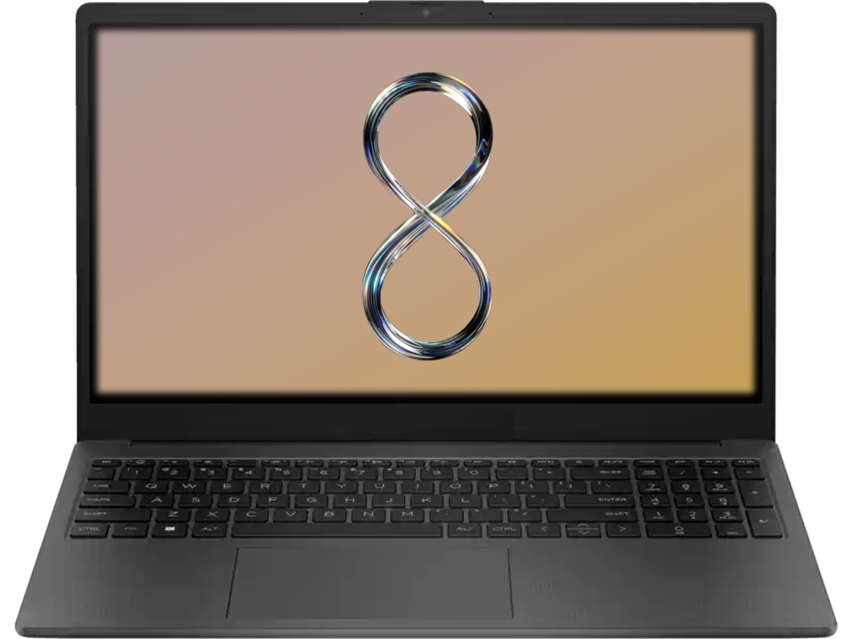



Windows 13 2024
Add a biometrics
Fingerprint
Windows Hello
Is this the right country or region?
English
Slovenia

Slide 74
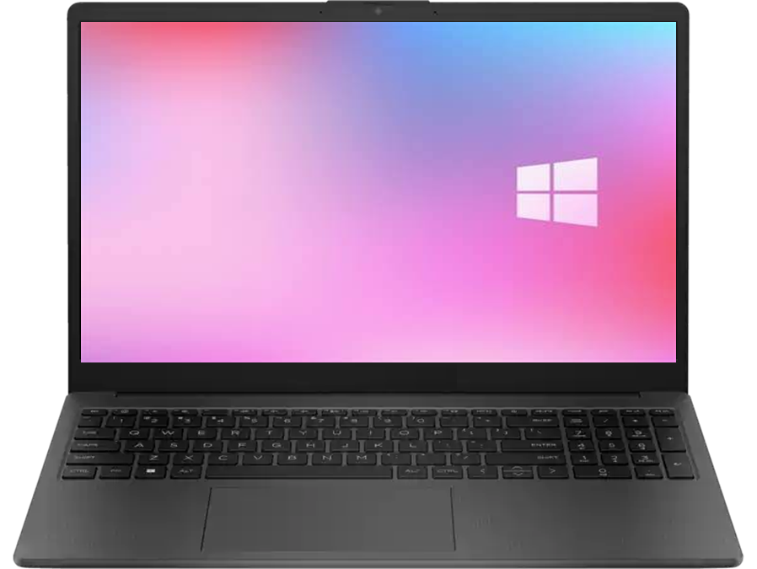
Windows 13 2024
Add a biometrics
Fingerprint
Windows Hello
Is this the right country or region?
English
Slovenia

Slide 75
Windows 13 2024
Add a biometrics
Add a biometrics
100%
0%
25%
Fingerprint
Fingerprint
Windows Hello
Windows Hello
Is this the right country or region?
English
Slovenia

Slide 76
Windows 13 2024
Is this the right country or region?
English
Slovenia

Slide 77



Windows 13 2024
Welcome back, Martin!
Restore from Martin‘s-PC
Set up as new device
Edit your account
Is this the right country or region?
English
Slovenia

Slide 78
Windows 13 2024
Welcome back, Marwanmohd Ahamed!
Restore from Marwanmohd Ahamed‘s-PC
Set up as new device
Edit your account
Is this the right country or region?
English
Slovenia

Slide 79

Windows 13 2024
Welcome back, Windows in PowerPoint!
Restore from Martin‘s-PC
Set up as new device
Edit your account
Is this the right country or region?
English
Slovenia

Slide 80









Windows 13 2024
Customize your experience
Entertainment
Gaming
School
Creativity
Family
Business
Is this the right country or region?
English
Slovenia

Slide 81

Windows 13 2024
Customize your experience
Entertainment
Gaming
School
Creativity
Family
Business
Is this the right country or region?
English
Slovenia

Slide 82
Windows 13 2024
Customize your experience
Entertainment
Gaming
School
Creativity
Family
Business
Is this the right country or region?
English
Slovenia

Slide 83

Windows 13 2024
Quick settings
OneDrive is your default cloud storage
Accept all privacy settings
Use Android phone from PC
Use Edge as default browser
Help to protect your PC from Viruses and Malwares
Turn on do not track in Edge
Help improve Microsoft software, services and location services by sendign us information
Check online for solutions to problems
Let apps give you personalized content based on your PC‘s location, name & account picture
Turn on sharing and connect to devices on this network
Is this the right country or region?
English
Slovenia

Slide 84
Windows 13 2024
Quick settings
OneDrive is your default cloud storage
Accept all privacy settings
Use Android phone from PC
Use Edge as default browser
Help to protect your PC from Viruses and Malwares
Turn on do not track in Edge
Help improve Microsoft software, services and location services by sendign us information
Check online for solutions to problems
Let apps give you personalized content based on your PC‘s location, name & account picture
Turn on sharing and connect to devices on this network
Is this the right country or region?
English
Slovenia

Slide 85

Windows 13 2024
Quick settings
OneDrive is your default cloud storage
Accept all privacy settings
Use Android phone from PC
Use Edge as default browser
Help to protect your PC from Viruses and Malwares
Turn on do not track in Edge
Help improve Microsoft software, services and location services by sendign us information
Check online for solutions to problems
Let apps give you personalized content based on your PC‘s location, name & account picture
Turn on sharing and connect to devices on this network
Is this the right country or region?
English
Slovenia

Slide 86
Windows 13 2024
Finishing Setup
This will take a while. So keep your PC on and plugged in. We’ll restart your PC once everything is ready.
Is this the right country or region?
English
Slovenia

Slide 87
Is this the right country or region?
English
Slovenia

Slide 88
Hi!
Is this the right country or region?
English
Slovenia

Slide 89
Is this the right country or region?
English
Slovenia

Slide 90
Getting things ready for you.
Is this the right country or region?
English
Slovenia

Slide 91
Is this the right country or region?
English
Slovenia

Slide 92
This might take a few minutes.
Do not turn off your PC or unplug your PC
Is this the right country or region?
English
Slovenia

Slide 93
This might take a few minutes.
Do not turn off your PC or unplug your PC
Is this the right country or region?
English
Slovenia

Slide 94
This might take a few minutes.
Do not turn off your PC or unplug your PC
Is this the right country or region?
English
Slovenia

Slide 95
This might take a few minutes.
Do not turn off your PC or unplug your PC
Is this the right country or region?
English
Slovenia

Slide 96
This might take a few minutes.
Do not turn off your PC or unplug your PC
Is this the right country or region?
English
Slovenia

Slide 97
This might take a few minutes.
Do not turn off your PC or unplug your PC
Is this the right country or region?
English
Slovenia

Slide 98
This might take a few minutes.
Do not turn off your PC or unplug your PC
Is this the right country or region?
English
Slovenia

Slide 99
This might take a few minutes.
Do not turn off your PC or unplug your PC
Is this the right country or region?
English
Slovenia

Slide 100
This might take a few minutes.
Do not turn off your PC or unplug your PC
Is this the right country or region?
English
Slovenia

Slide 101
This might take a few minutes.
Do not turn off your PC or unplug your PC
Is this the right country or region?
English
Slovenia

Slide 102
Is this the right country or region?
English
Slovenia

Slide 103
Almost there.
Is this the right country or region?
English
Slovenia

Slide 104
Is this the right country or region?
English
Slovenia

Slide 105










Search here
Get started
13:30

Slide 106
Search here
Get started
13:31

Slide 107
Search here
Get started
13:31

Slide 108










Search here
Get started
13:31
Good Afternoon, Windows in PowerPoint!
How to download Phyton.pdf 1 h
C:\Users\wppt\OneDrive\Tips
Wallpaper.psd 1 d
C:\Users\wppt\OneDrive\Photoshop
More

Slide 109
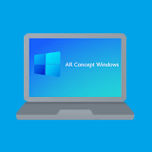
Search here
Get started
Good Afternoon, Marwanmohd Ahamed!
How to download Phyton.pdf 1 h
C:\Users\wppt\OneDrive\Tips
Wallpaper.psd 1 d
C:\Users\wppt\OneDrive\Photoshop
More
13:31

Slide 110
Search here
13:31
Get started
Get started
Good Afternoon, Marwanmohd Ahamed!
How to download Phyton.pdf 1 h
C:\Users\wppt\OneDrive\Tips
Wallpaper.psd 1 d
C:\Users\wppt\OneDrive\Photoshop
More
Good Afternoon, Windows in PowerPoint!
How to download Phyton.pdf 1 h
C:\Users\wppt\OneDrive\Tips
Wallpaper.psd 1 d
C:\Users\wppt\OneDrive\Photoshop
More

Slide 111
Search here
Get started
Settings
13:32

Slide 112












Search here
Settings
Windows in PowerPoint
windows.videa@gmail.com
Home
HP – Winppt
HP 255 G7
Windows Update
Last checked: 1m ago
Home
Rename
System
Bluetooth & devices
Personalize your device
Network & internet
Personalization
Apps
Accounts
Time & language
13:32

Slide 113
Search here
Settings
Marwanmohd Ahamed
marwanmohammedahamed40@gmail.com
Home
Desktop-8DKF923
PowerPoint Machine-94HG
Windows Update
Last checked: 1m ago
Home
Rename
System
Bluetooth & devices
Personalize your device
Network & internet
Personalization
Apps
Accounts
Time & language
13:32

Slide 114
Search here
Settings
13:32

Slide 115



Search here
Pause Windows 13
Restart
Power OFF
13:33

Slide 116
Search here
Pause Windows 13
Restart
Power OFF
13:33

Slide 117
Search here
Settings
13:33

Slide 119
Shutting Down

